Slide 1
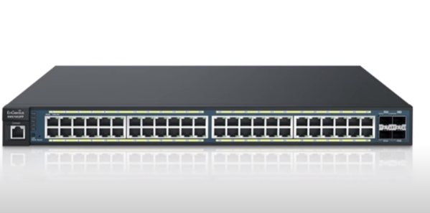
VLAN

Slide 2
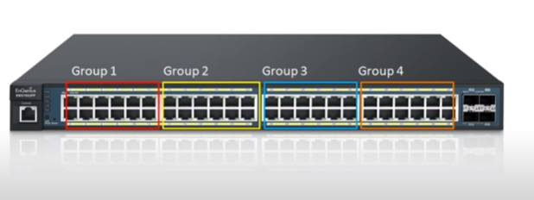
VLAN

Slide 3
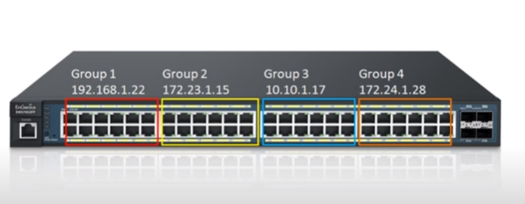
VLAN

Slide 4
Cut-Through Switch

